Slide 1
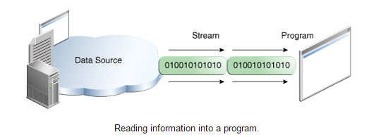
I/O Streams
Java application uses an input stream to read data from a source, it may be a file, memory arrays, peripheral device or socket
InputStream
Java application

Slide 2
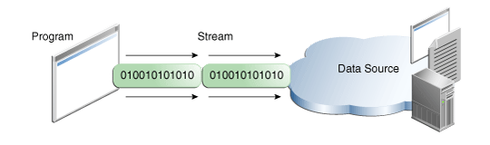
I/O Streams
Java application uses an output stream to write data to a destination, it may be a file, memory arrays, peripheral device or socket
Java application
OutputStream

